Slide 1
ВИКТОРИНА ПО АНГЛИЙСКОМУ ЯЗЫКУ
« Мир животных.»
3 классы

Slide 2
S | F | X | F | S | S | S | S | X | R | V | B | Y | U
X | R | X | H | B | I | R | D | l | L | L | L | L | L
E | O | X | Y | G | Z | X | C | D | E | R | T | Y | K
R | G | X | B | H | H | T | O | R | T | O | I | S | E
C | E | N | L | F | D | V | V | B | C | X | D | E | R
T | Y | F | F | T | Y | U | I | O | P | [ | A | S | W
C | R | O | C | O | D | I | L | E | R | T | Y | H | B
Y | T | V | E | D | G | H | B | F | C | N | M | L | G
H | H | H | V | C | G | G | L | L | L | C | V | S | B
N | Y | I | F | S | E | A | H | O | R | S | E | D | H
J | U | P | T | G | H | H | C | N | X | R | X | D | Y
M | J | P | G | T | N | Y | V | N | F | D | C | B | N
O | N | O | B | B | M | S | P | I | D | E | R | E | M

Slide 3
 | F
 | R |  |  | B | I | R | D
 | O
 | G |  |  |  |  | T | O | R | T | O | I | S | E
C | R | O | C | O | D | I | L | E
 |  |  |  | S | E | A | H | O | R | S | E
 |  |  |  |  |  | S | P | I | D | E | R

Slide 4


Расставь названия
1
tail
2
head
3
ears
4
nose
5
eyes
6
foot

Slide 5
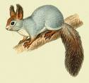
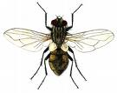

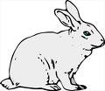
Какие животные изображены на картинках?
a
a
b
c
d
Dolphin
Squirrel
Fly
Cow
Goat
Dolphin
Fly
Squirrel
Fly
Dolphin
Squirrel
Turtle
Squirrel
Fly
Hare
Dolphin

Slide 6
Какое число больше?
seventeen + sixty
или
seventy + sixteen

Slide 7
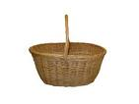
Разложи продукты в 2 корзины
milk
cheese
potato
carrot
meat
orange
tea
sandwich
juice
nut
drinks
food

Slide 8
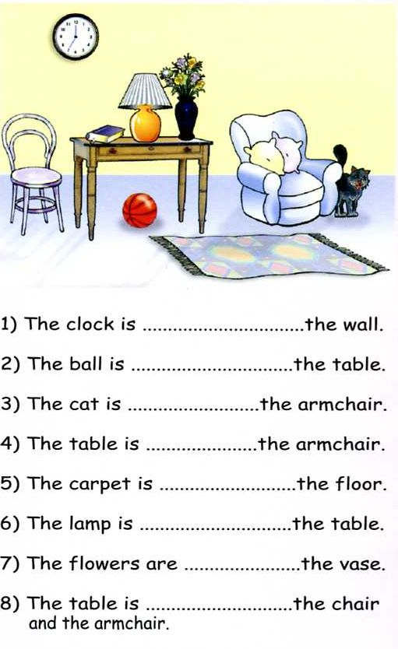

Slide 9
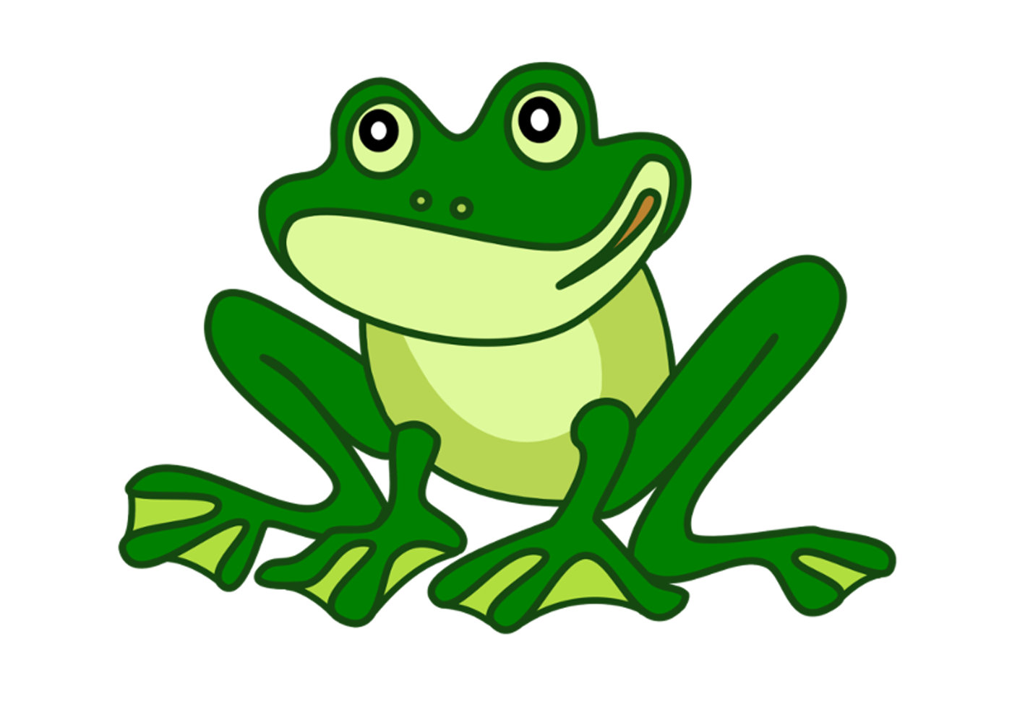
1.I can jump, but I can’t fly.
I live in the water and I am green.

Slide 10
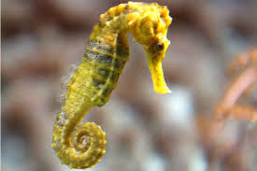
1.I can swim, but I can’t fly.
I live in the water and I look like a horse.

Slide 11
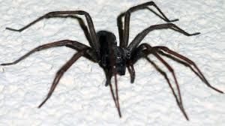
1.I can crawl, but I can’t fly.
I can be black or brown. I live in the forests and in the houses.

Slide 12
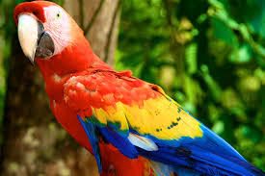
1.I can talk, I can fly. I can’t swim.

Slide 13
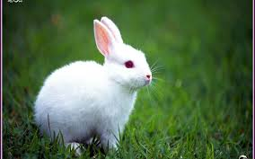
1.I can jump, I can’t fly. I can’t swim. I am fast.

Slide 14
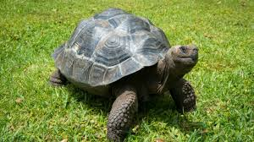
1.I can walk, but I can’t fly.
I am very slow.

Slide 15
There is a big house in the centre of the picture.
The house is yellow with red roof (крыша).
There are two windows in the house and one door. To the left( слева) of the house there is a green tree.
To the right(Справа) of the house there are two flowers. One flower is red, the second flower is blue. Under the tree there is a black dog.
On the tree there is a white fat cat.

Slide 16
